Slide 1
OPER 623 – Heuristic Search Methods
Lesson 13
Genetic Algorithms

Slide 2
Outline
Introduction
Essentials
Population size
Fitness values
Parent selection
Child generation
Updating population
Simple Example
Convergence
Group Application

Slide 3
Outline
Introduction
Essentials
Population size
Fitness values
Parent selection
Child generation
Updating population
Simple Example
Convergence
Group Application

Slide 4
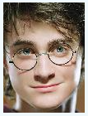
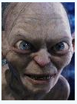
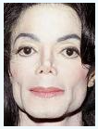
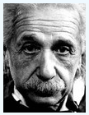
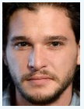
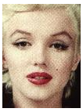
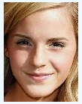
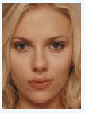
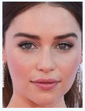
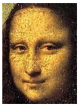
Genetic Algorithms Basic Idea
Start with a population

Slide 5
Genetic Algorithms Basic Idea
7
1
5
10
8
5
7
4
8
10
Evaluate population fitness

Slide 6
Genetic Algorithms Basic Idea
7
1
5
10
8
5
7
4
8
10
Select parents

Slide 7
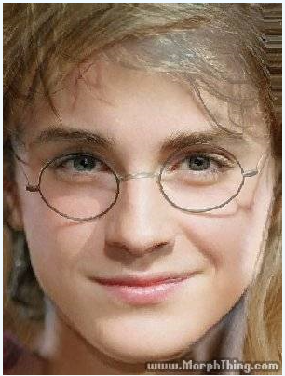
Genetic Algorithms Basic Idea
Combine parent attributes to form “offspring”

Slide 8
Genetic Algorithms Basic Idea
7
5
5
10
8
5
7
4
8
10
Update population

Slide 9
Genetic Algorithms History
Initially developed by John H. Holland with colleagues at the University of Michigan in the 1960s and 1970s.
Appeared in Holland's book Adaptation in Natural and Artificial Systems published in 1975.
Goals
To abstract and rigorously explain the adaptive process of natural selection
Design adaptive artificial software that retains the important mechanisms of natural selection

Slide 10
Genetic Algorithms Features
Can successfully deal with a wide range of problem areas
Including those which are difficult for other methods to solve
Not guaranteed to find the global optimum solutions
Common with all heuristics
Generally good at finding “acceptably good” solutions “acceptably quick”
Does not require much in the way of mathematical requirements

Slide 11
Genetic Algorithms Features
A population-based model that uses selection and recombination operators to generate new sample points in a search space
GAs search using a population of solutions versus a single point
GAs use probabilistic transition rules

Slide 12
Genetic Algorithms Definitions
Chromosome: component vector, traditionally a string of 0s and 1s, but more exactly a representation of a solution.
Genes: specific variables
Alleles: possible values of a variable (gene)
Locus: position of a gene in the chromosome (index)

Slide 13
Genetic Algorithm Essential Components
Population size
Fitness values
Parent selection
Child generation
Updating population

Slide 14
Genetic Algorithm Essential Components
Population size
Fitness values
Parent selection
Child generation
Updating population

Slide 15
Population Size
Small populations risk not covering the solution space.
Large populations incur computational penalties.
Alander suggests that a value between n and 2n is best for a problem with input size n (length chromosome = n).

Slide 16
Genetic Algorithm Essential Components
Population size
Fitness values
Parent selection
Child generation
Updating population

Slide 17
Fitness Value
A measure of the quality of each chromosome in the population.
Often relates to the value of the objective function value, but not always.
Penalizing infeasibility is a common addition to a fitness function
Generally, the higher the fitness value, the higher the probability that chromosome is chosen as a parent.

Slide 18
Fitness Encoding Issues
Usual coding scheme is binary
This is the fundamental approach GA theory is based on
There are other coding schemes
Chromosome feasibility is an issue
Does the resulting “child” chromosome lie in the feasible space of the problem?
This can become a problem when constraints are involved
Penalty functions can be used as part of fitness value
You can also use various repair mechanisms (see reading for details)

Slide 19
Fitness Encoding Issues
What if we’re not solving a binary problem?
Can use phenotypic representation
Phenotype = “What we see”
Example: 15 25 32
Drawbacks?
Can convert to genotypic
Genotype = “What is causing what we see”
Binary encoding – represent any whole number as a binary string
Example: 1011001 (binary) = 89 (decimal)

Slide 20
Genetic Algorithm Essential Components
Population size
Fitness values
Parent selection
Child generation
Updating population

Slide 21
Parent Selection Process
Proportional selection of parents
Probability of selection is proportional to fitness of parents
Weighted Roulette wheel is typical analogy
Rank selection
Based on parent fitness rankings
Ignores magnitude of value difference
Elitist
Ensure the best survive
Tournament
Randomly pick a sub-sample; best is selected
Group selection
Proportionally select a ranked group based on fitness then select individual from in that group
Notes:
Proportional selection => example is roulette wheel
process in which individuals strings are copied according to their objective function values, f
Think of f as measure of profit, utility, or goodness we want to maximize
Copy strings according to objective fn
Means strings with higher values have higher prob of contributing one or more offspring in next generation
This is artificial version of natural section obj fn final arbiter of string-creatures life or death
Rank order
Ignores magnitude of value difference
Generally delete by inverse rank (incremental GA)
Could possible use uniform deletion (incremental GA)
Elitist like rank order but insures best is copied over
Tournament
Scaling => linear, sigma truncation, power law
Rank order exploits more at cost of exploration- greedy algo

Slide 22
Seeding
“Seed” a population with high-quality solutions to start (obtained from another heuristic technique) can help a genetic algorithm find better solutions more quickly than from a random start.
However, note this can lead to an increased change of premature convergence to a high quality but local optima.

Slide 23
Genetic Algorithm Essential Components
Population size
Fitness values
Parent selection
Child generation
Updating population

Slide 24
Genetic Algorithms Genetic Operators - Crossover
Most fundamental operator is a crossover
Given two parents
Choose a crossover point

Slide 25
Genetic Algorithms Genetic Operators - Crossover
Most fundamental operator is a crossover
Select “left” genes from Mom and “right” genes from Dad

Slide 26
Genetic Algorithms Genetic Operators - Crossover
Most fundamental operator is a crossover
Produces a new offspring

Slide 27
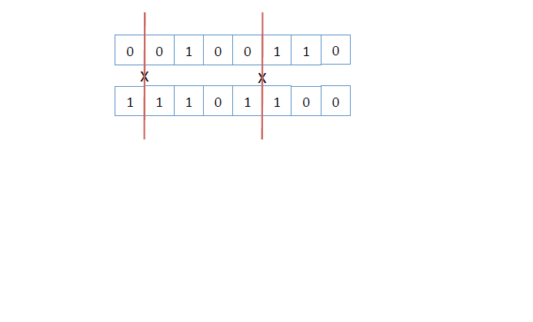
Genetic Operators – Crossover Multi-point Crossover
No need to limit to one crossover point.

Slide 28
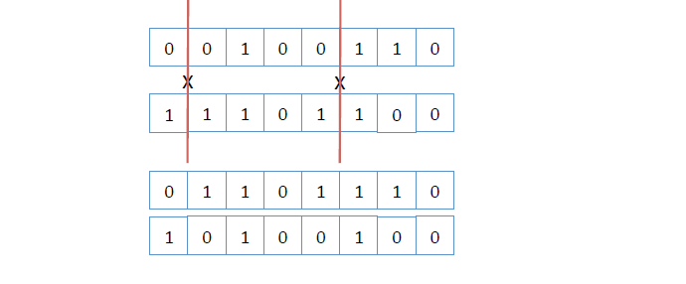
Genetic Operators – Crossover Multi-point Crossover
No need to limit to one crossover point.

Slide 29
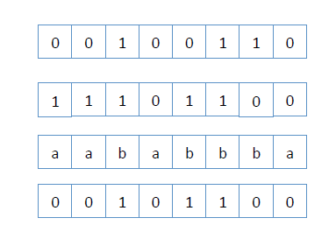
Genetic Operators – Crossover Generalized Crossover
Generalize the crossover to pull from each parent randomly.
Parent a
Parent b

Slide 30
Genetic Operators – Crossover Generalized Crossover
Generalize the crossover to pull from each parent randomly.
Parent a
Parent b

Slide 31
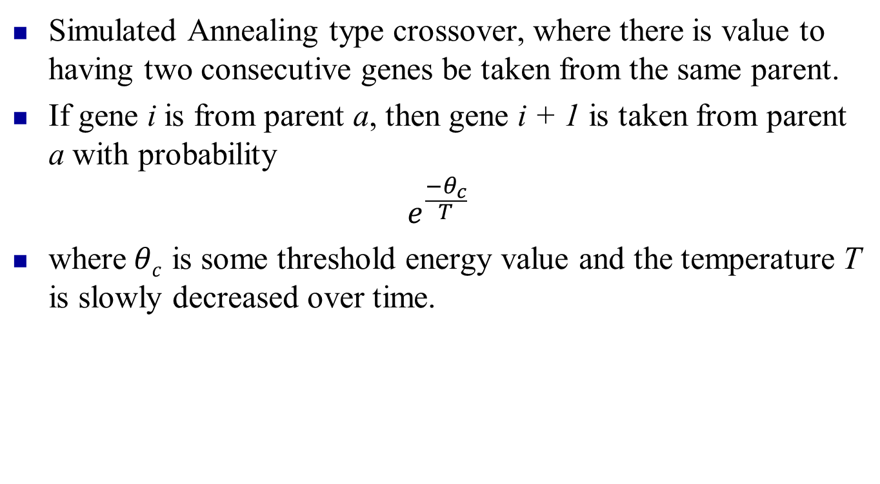
Genetic Operators – Crossover SA Based Crossover
Simulated Annealing type crossover, where there is value to having two consecutive genes be taken from the same parent.
If gene i is from parent a, then gene i + 1 is taken from parent a with probability
$$e^{\frac{−θ_{c}}{T}}$$
where$θc$ is some threshold energy value and the temperature T is slowly decreased over time.

Slide 32
Genetic Operators – Crossover
There is a sweet spot in the number of crossover points
2 or 3 crossover points is often better then 1, as it introduces more variability
Too many crossovers increases variability too much and valuable information from inheritance is lost
No agreement on the Goldilocks number of crossover points

Slide 33
Genetic Algorithms Genetic Operators - Mutation
A random modification of a chromosome
Prevents premature convergence of population
Define some mutation probability p, and each gene mutates (switches value) with probability p

Slide 34
Genetic Algorithms Genetic Operators - Mutation
A random modification of a chromosome
Define some mutation probability p, and each gene mutates (switches value) with probability p
p = 0.02

Slide 35
Genetic Algorithms Genetic Operators - Mutation
A random modification of a chromosome
Define some mutation probability p, and each gene mutates (switches value) with probability p
p = 0.02

Slide 36
Genetic Algorithms Genetic Operators - Mutation
A random modification of a chromosome
Define some mutation probability p, and each gene mutates (switches value) with probability p
p = 0.02

Slide 37
Genetic Algorithms Genetic Operators - Mutation
A random modification of a chromosome
Define some mutation probability p, and each gene mutates (switches value) with probability p
p = 0.02

Slide 38
Genetic Algorithm Essential Components
Population size
Fitness values
Parent selection
Child generation
Updating population

Slide 39
Updating Population
Once one or more offspring have been generated the heuristic needs to update the population.
Holland's original GA generated offspring equal to the size of the population and then replaced the entire population.
Other possibilities:
Replace parents
Replace worst

Slide 40
Updating Population
Generation Gap
Randomly parse population into two groups. From group A select (somehow) parents. Sufficient offspring are then produced to replace the entire population of group B.
Elitist Model
Regardless of choices always maintain the best members of prior population

Slide 41
Outline
Introduction
Essentials
Population size
Fitness values
Parent selection
Child generation
Updating population
Simple Example
Convergence
Group Application

Slide 42
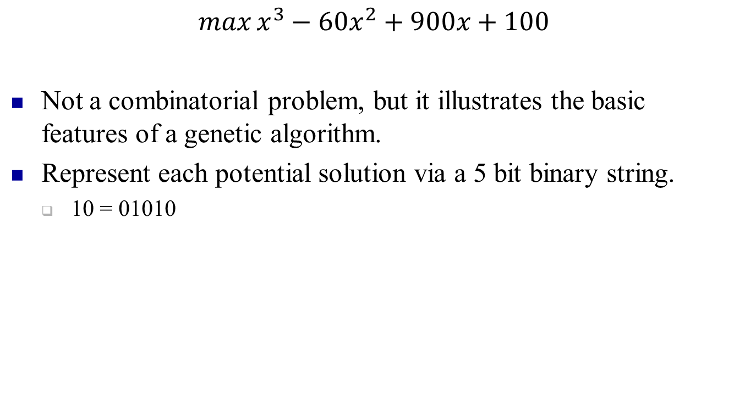
Simple Example
$$\max{x^{3}−60x^{2}+900x+100}$$
Not a combinatorial problem, but it illustrates the basic features of a genetic algorithm.
Represent each potential solution via a 5 bit binary string.
10 = 01010

Slide 43
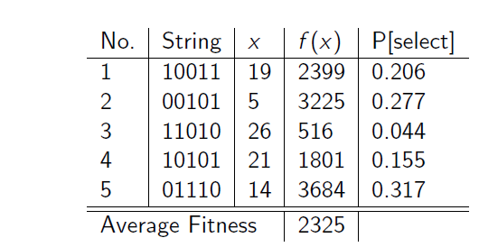
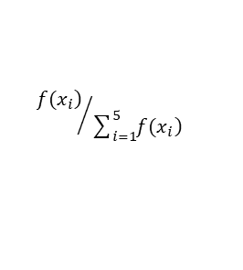
Simple Example
$${\left.f(x_{i}\right)}/{\sum_{i=1}^{5}{\left.f(x_{i}\right)}}$$
Set objective function value f(x) as fitness value
First parent is selected with probability based on fitness value
Second parent is uniformly randomly selected
Crossover occurs at randomly determined point
Mutation occurs with probability p = 0.02
5 offspring are generated, and replace original population

Slide 44
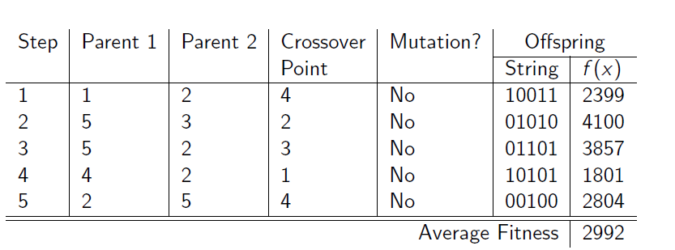
Simple Example
Note that offspring (aka new population) have a higher average fitness then original population!
While any individual ‘generation’ may not produce a better “best” as average fitness increases the likelihood of a better “best” increases.

Slide 45
Outline
Introduction
Essentials
Population size
Fitness values
Parent selection
Child generation
Updating population
Simple Example
Convergence
Group Application

Slide 46
Convergence
Convergence is the progression towards increasing uniformity
A gene is converged when 95% of the population share the same value
A population has converged when all the genes have converged
Potential Problems
Pre-mature convergence occurs when dominate genes take over the characteristics of the population
This can be a problem when these “super genes” are associated with local optima
Slow convergence occurs when two or more genes converge on two or more local optima with similar fitness values

Slide 47
Convergence
Selection for reproduction intensifies on quality “schema” and converge to good solutions
Crossover and Mutation facilitate diversification, so the population doesn’t converge prematurely
Population size has large impact
Size too small then GA may converge too quickly
Size too large may waste computational resources

Slide 48
GA Summary Game
Given a population ‘some how’ choose parents
If your parent selection method too pedantically chooses the ‘best’ parents you ____
If your parent selection method is too random you ____
Once you have parents you create offspring ‘some how’
Too little randomness in generation you ____
Too much randomness you ___
Once you have children you need to decide on mutation
No mutation you ____
Too much mutation you ____
Next you update the population
Do you get rid of all parents, some parents, worst parents?
A) you risk premature convergence
B) you ignore valuable suitability information

Slide 49

Break

Slide 50
Solving a Complex Pathway
GIVEN: A complex map
GOAL: Get from point A to point B via shortest distance.
HOW: There are 5 branches to every path on the map. At each branch you can go left (L), straight (S), or right (R).
Use a random number generator to get five (5) uniform random numbers [0,1].
[0,.333) = L [.333, .666) = S [.666, 1] = R This is your path.
Calculate the distance associated with your path.
Everyone Stand
If you are in the longest |2/3 of class size| distances you die. Sit down.
Dead students now “randomly” draw front half of a new path from one living student and back half from a different student.
Calculate length of these new paths.
Repeat steps 3-6
I will periodically introduce a mutation by replacing a letter in a path with a different letter.

Slide 51
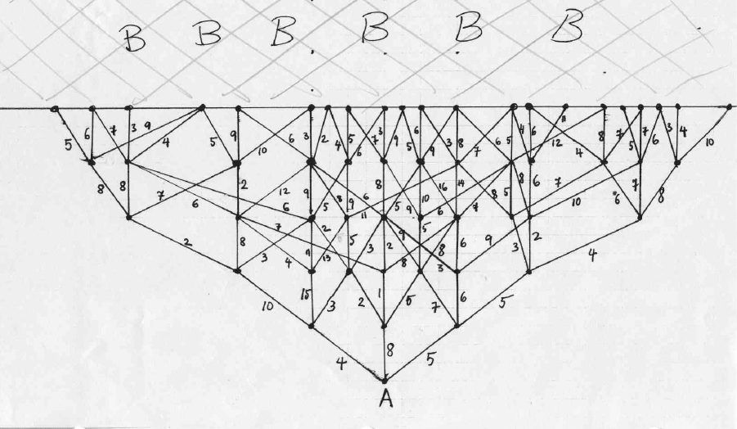
MAP

